Slide 1
DESIGN AND IMPLEMENTATION OF A MOBILE-BASED ARCHIVAL AND RETRIEVAL OF MISSING OBJECTS APPLICATION USING IMAGE MATCHING
TASK 5: DESIGN AND IMPLEMENTATION
GROUP1
DESIGN AND IMPLEMENTATION PHASE

Slide 2
OUTLINE
Introduction
1.1. Project overview
1.2. Report objective
2. User Interface design
2.1. Design Principles
2.2 Design Tools and Technologies
2.3 User Style Guide
2.4 Pages and Description

Slide 3
INTRODUCTION

Slide 4
USER INTERFACE DESIGN

Slide 5
DESIGN PRINCIPLES
User-Centered Design
Usability and Acceptability
Minimalistic Design

Slide 6
DESIGN TOOLS AND TECHNOLOGIES
Design Software
Figma
Prototyping Software
Figma

Slide 7
USER INTERFACE STYLE GUIDE
Color Scheme
Typography
Components
Navigation

Slide 8




USER INTERFACE STYLE GUIDE
Color Scheme
Primary color: Medium slate blue (#6C63FF)
Secondary Color: Mint Green (#C3FDC2)
Danger color: Pink (#F24343)
Background color: Light gray (#EEEEEE)
Text color: Dark Gray (#444444)

Slide 9
USER INTERFACE STYLE GUIDE
Typography
Font-family : Poppins
Font-weights: Bold, semi-bold, medium, regular
Font sizes
Normal text: 14px , 16px , 18px
Headings 20px 22px
Page Titles: 28px

Slide 10
USER INTERFACE STYLE GUIDE
Components
Text paragraphs
Buttons
Cards
Modals
Inputs
Grid layouts

Slide 11
USER INTERFACE STYLE GUIDE
Navigation
Bottom Navigation bar
Side Drawer navigation
Push Navigations (Buttons and back arrows)

Slide 12
PAGES AND DESCRIPTION

Slide 13
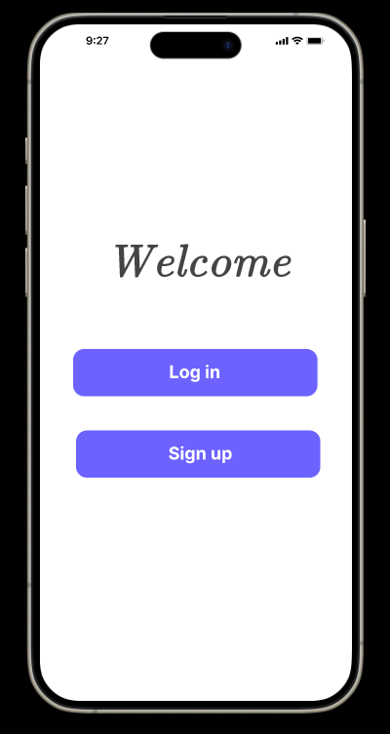
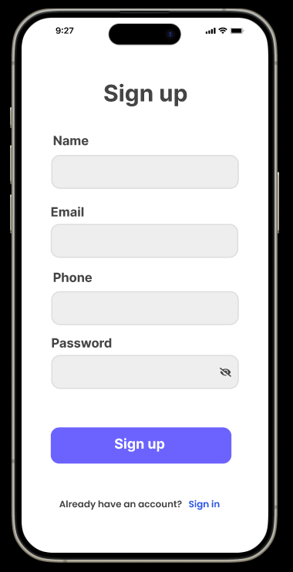
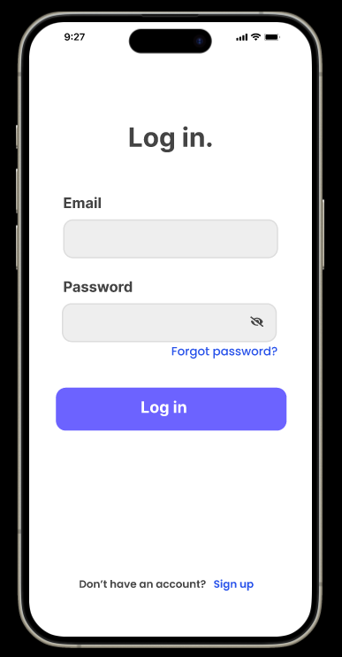
WELCOME
SIGNUP
LOGIN

Slide 14
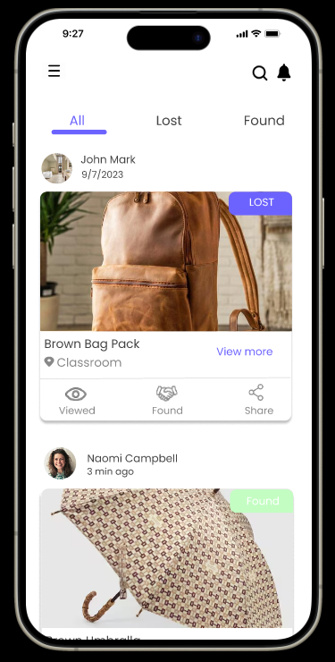
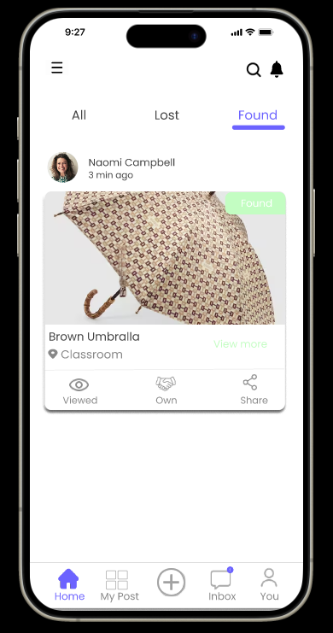
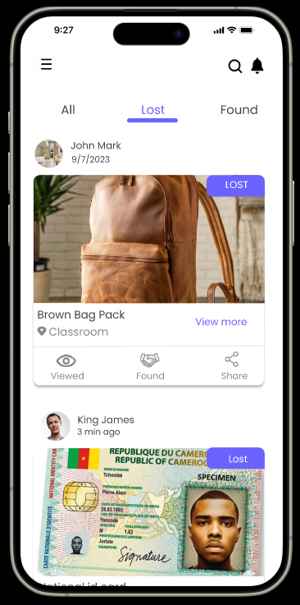
HOME (ALL)
HOME (FOUND)
HOME (LOST)

Slide 15
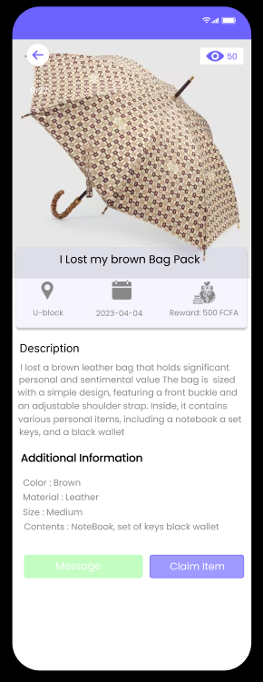
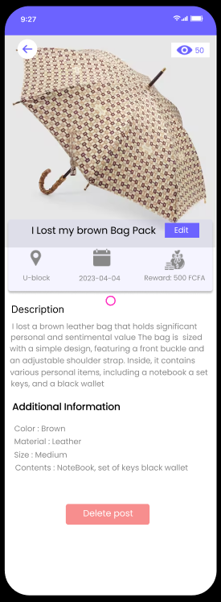
DETAILS PAGE
( ANOTHER USER’S POST )
DETAILS PAGE
( USER’S OWN POST )

Slide 16
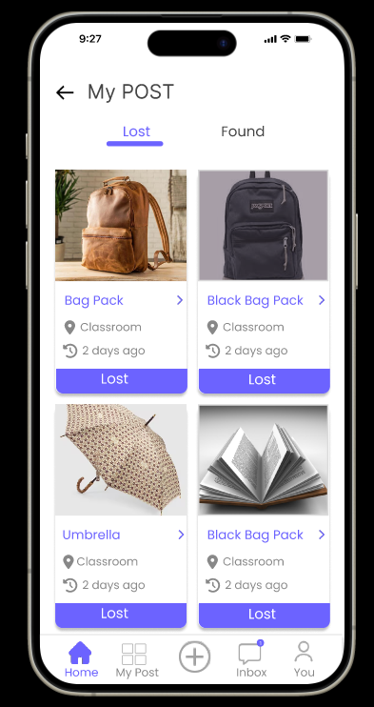
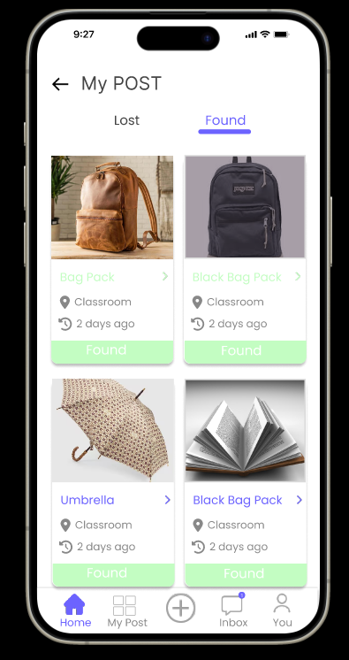
USER POSTS PAGE (LOST)
USER’S POSTS PAGE (FOUND)

Slide 17
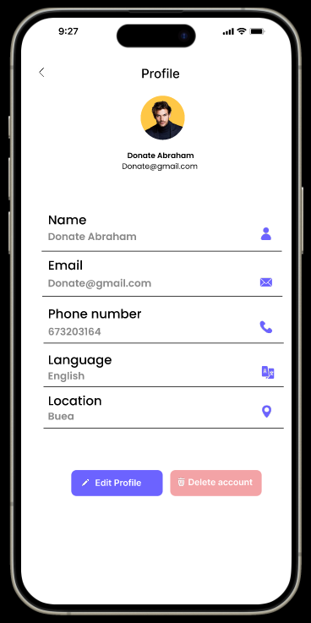
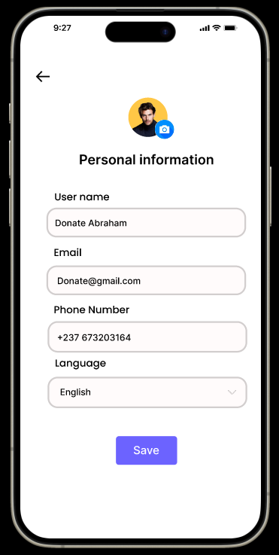
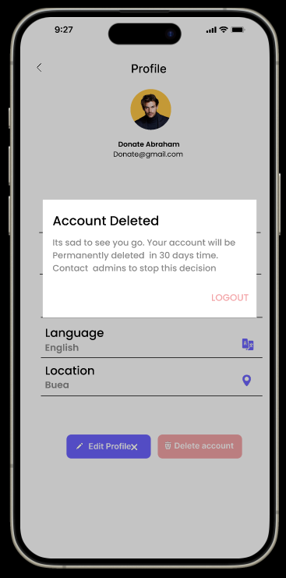
PROFILE
EDIT PROFILE
DELETE MODAL

Slide 18
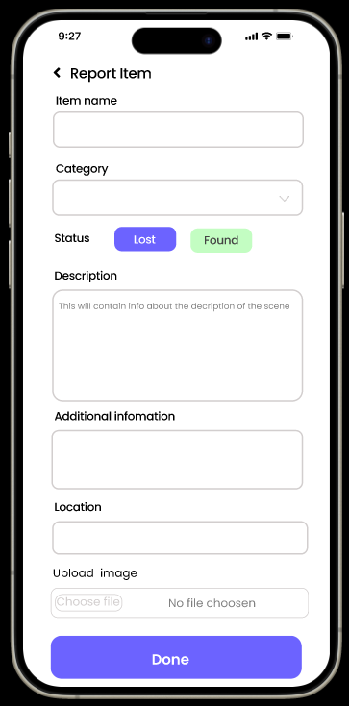
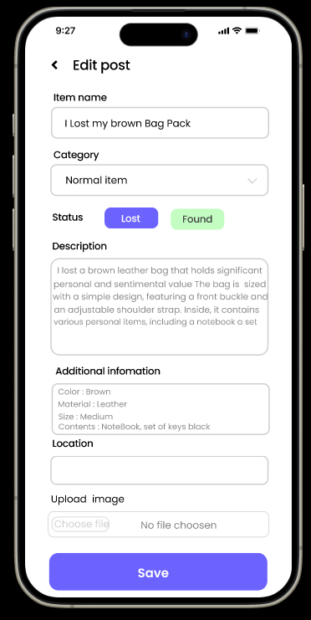
REPORT NEW ITEM
EDIT REPORTED ITEM

Slide 19
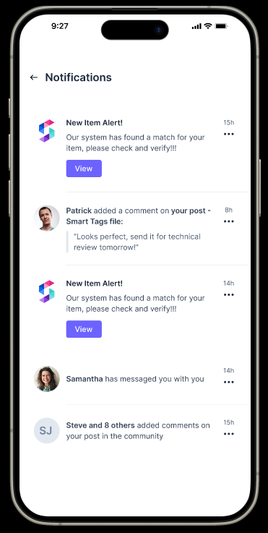
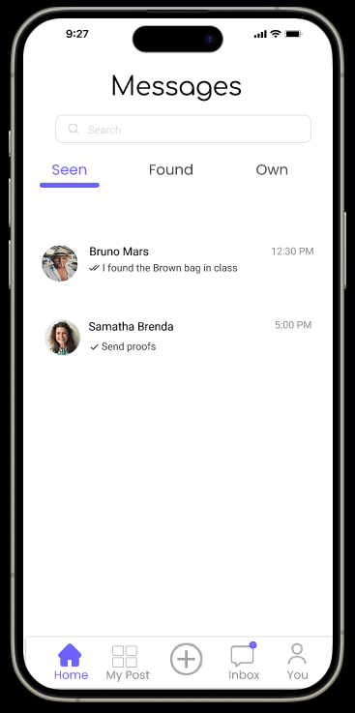
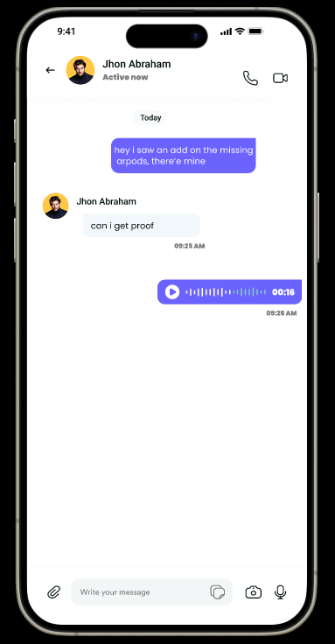
NOTIFICATIONS
MESSAGES
CHAT PAGE

Slide 20
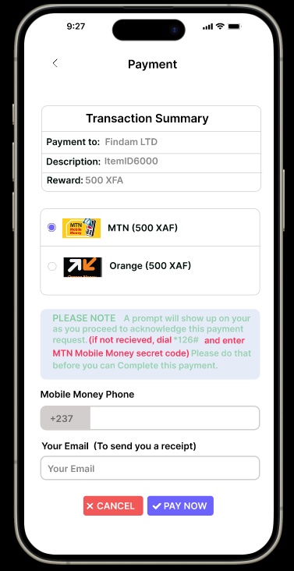
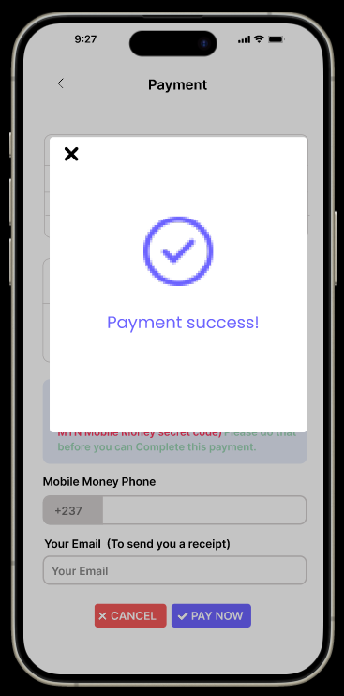
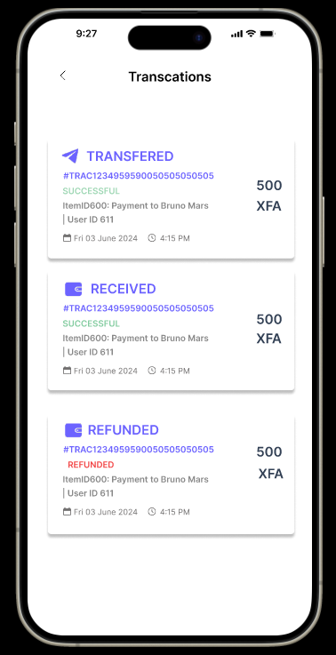
PAYMENT
CONFIRMATION
TRANSACTION
HISTORY

Slide 21
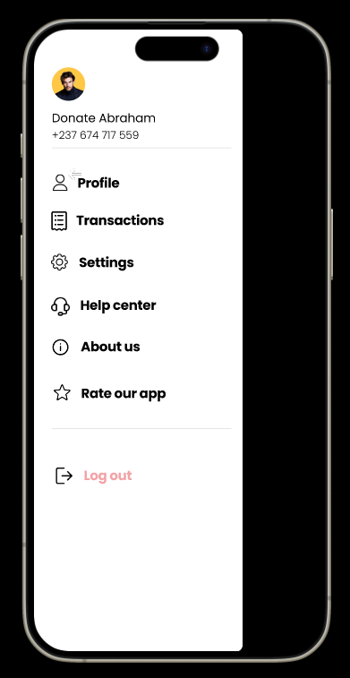
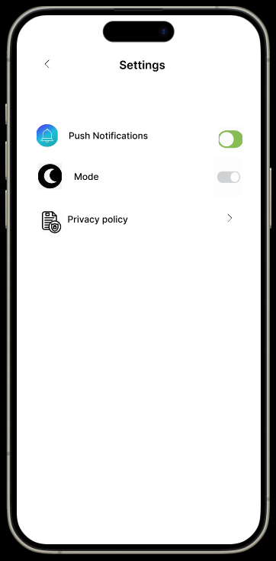
SIDE DRAWER
SETTINGS

Slide 22
USER INTERFACE IMPLEMENTATION

Slide 23
FRAMEWORK AND LIBRARIES
FRAMEWORK
React-Native
Expo
LIBRARIES
React Navigation
Formik, Yup
Expo-app-loading
Expo-splash screen
Expo-font
Expo-vector-Icons

Slide 24
CODE STRUCTURE
PARENT FRONTEND DIRECTORY
Node_module
Pakage.json
Routes
Shared
Screens
Styles

Slide 25
CODE STRUCTURE
PARENT FRONTEND DIRECTORY
Node_module
Pakage.json
Routes
Shared
Screens
Styles

Slide 26
STYLING LIBRARIES AND STATE CONTROL
STATE MANGAEMENT
Contexts and hooks
Props
STYLING LIBRARY
React Native papers

Slide 27
TESTING AND ITERATION
USER FEEDBACK
User testing walkthrough
Iterative updating
TESTING TOOL
Expo-Go
Mobile device

Slide 28
Conclusion

